Slide 1




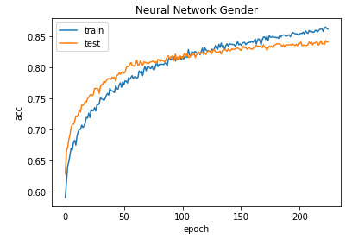
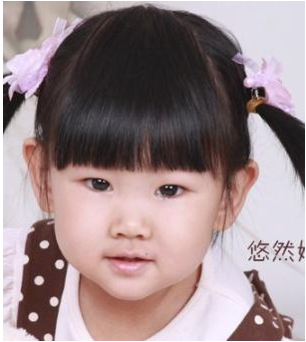
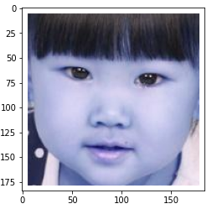
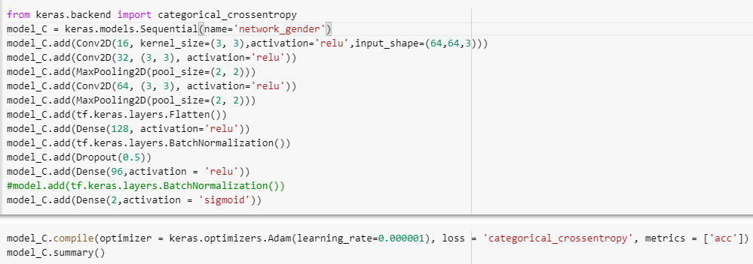
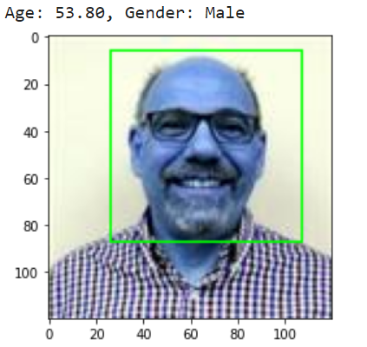
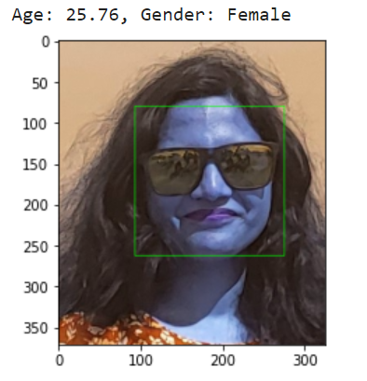
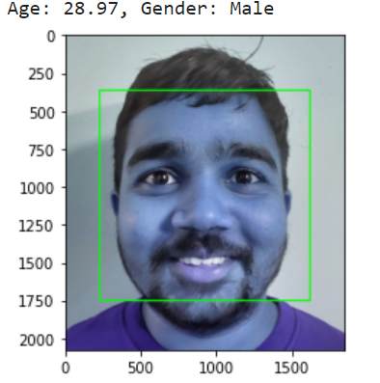
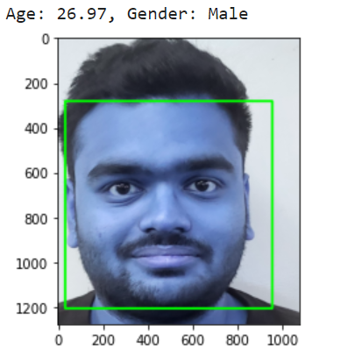
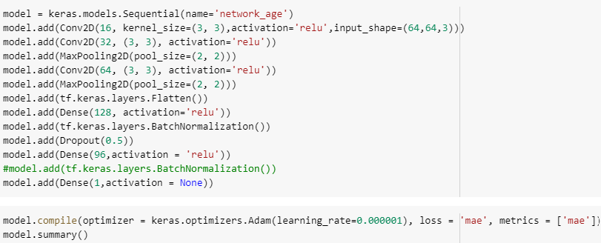
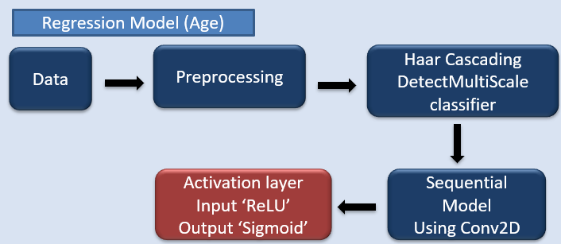
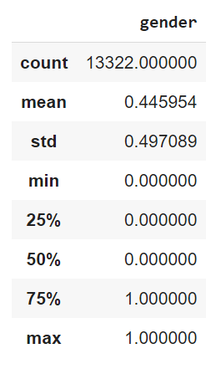
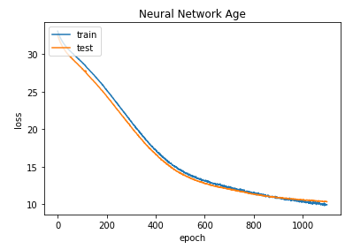
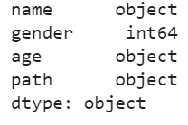
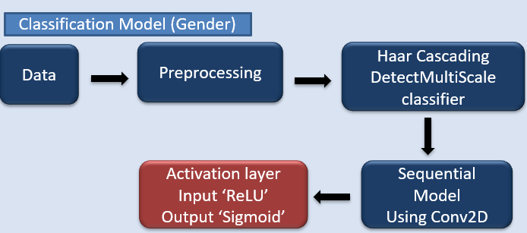
Age and Gender Prediction Using Computer Vision
CAPSTONE PROJECT Student: ROHITH UPPULA – U01829154
Introduction
Computer Vision Pipeline
Visualizations
When searching for strangers, for example, age and gender are two of the most frequently used attributes of a person.
Therefore, we take advantage of this opportunity to create a computer vision system based on machine learning to determine a subject's age and gender from a digital snapshot..
Although this problem can be resolved manually for small datasets, it will be difficult to deal with very large databases.
The pipeline involves following steps:
Extracting the data from the All-Age-Faces zip file.
Two CSV files are present, along with the photos that should be in a single data frame. Prior to creating a data frame, combine the two sets of data, sort the data frame, and replace the names of the two columns with Name and Gender.
Created a new column ‘age’ by extracting the age by slicing the name from column ‘name’.
Data preprocessing in which files from the extracted zip file that contain the image name, the requested gender, and the image's source are joined into a Python data frame using pandas.
By importing Cv2 and using the imread function to convert the photos to NumPy array format, the images were sorted in a language that a computer could understand.
The face was extracted from the photos using the Haar Cascading method. by normalizing the images, scaling the images to (64,64), reshaping them into (64,64,3,1), utilizing the frontal face xml file, and the detectMultiScale function.
If the function detects a single face in an image, it stores the image data associated with the image age and gender in three different variables.
Now, x is the variable where we store the images in NumPy array format, ages in y variable (object type), and genders in z variable (integer type), with both y and z variables serving as the target variables.
The architecture of Neural network is created by using Sequential model by importing tensor flow, keras along with that Conv2D, Dense, MaxPooling2D, Dropout, Flatten layer are used for predicting the age, measuring the model performance by metric mean absolute error.
For preditcing the gender, by same model, with the activation function sigmoid and the model will be measured by metric accuracy.
Haar Cascading Frontal face
Literature Review
Results Analysis
In this study, the age and gender of the subject are classified using a 2D convolutional neural network.
Supervised Learning, a machine learning model discovers patterns in labeled data(gender: Male, Female, age: 0-80) and generates corresponding labeled predictions.
Convolutional neural networks is created specifically to handle and train input that is connected to "signals," such as images and audio. Conv2D will assist in extracting the facial features from the digital photograph, allowing us to train the neural network to predict.
Deep learning is a branch of machine learning whose methods are based on how the brain processes information. The supervised data we are feeding the ANN is being trained to predict age and gender.
CNN Model For Predicting age and Gender
Recommendation System | Metric
Regression Model (Age) | 9.9294 (Mean Absolute Error)
Classification Model (Gender) | 85% (Accuracy)
Data Collection
CNN Model For Predicting age and Gender
Conclusion
The dataset consists of two files: one file is a zip file containing all the photos, while the second file has information about each shot, including its file name and gender (Male, Female).
The zip file contains 13,322 images overall, all of which are in the three RGB channel format..
The age and gender of the subjects in the photographs are predicted using the All-Age-Faces dataset. The data collection is publicly available on GitHub..
This project is about predicting age and gender based on a digital snapshot.
Creating a neural network is simple for anyone with little knowledge of the concept, but to get the best results, you must build a great architecture neural network and properly preprocess the data.
To complete the task, the Haar Cascading methodology utilized to crop the face from the digital image.
Statistics :
Neural Network Performance:
References
Cuimei, L., Zhiliang, Q., Nan, J. and Jianhua, W., 2017, October. Human face detection algorithm via Haar cascade classifier combined with three additional classifiers. In 2017 13th IEEE International Conference on Electronic Measurement & Instruments (ICEMI) (pp. 483-487). IEEE.
Wagner, P., 2012. Machine learning with opencv2. 2016-03-10]. http://www. bytefish. de.
Agarwal, M., Gupta, S. and Biswas, K.K., 2021. A new Conv2D model with modified ReLU activation function for identification of disease type and severity in cucumber plant. Sustainable Computing: Informatics and Systems, 30, p.100473.
RESEARCH POSTER PRESENTATION TEMPLATE © 2019
www.PosterPresentations.com

